Slide 1

SUB POP
THE MAKING OF A DATABASE
Nicholas Catani

Slide 2
What DID GO WELL?

Slide 3
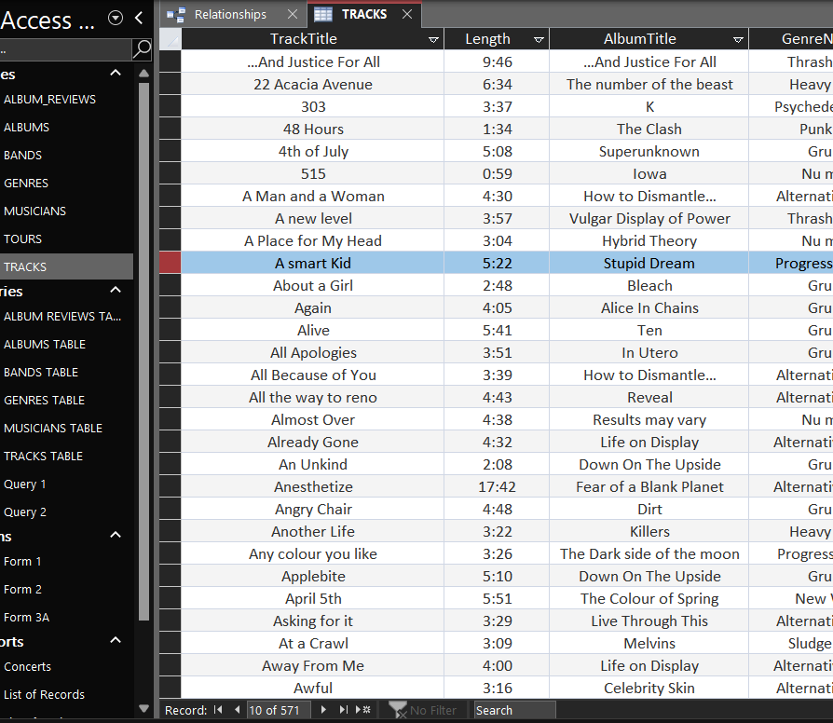
ENOUGH TIME TO PERFOM DATA ENTRY

Slide 4
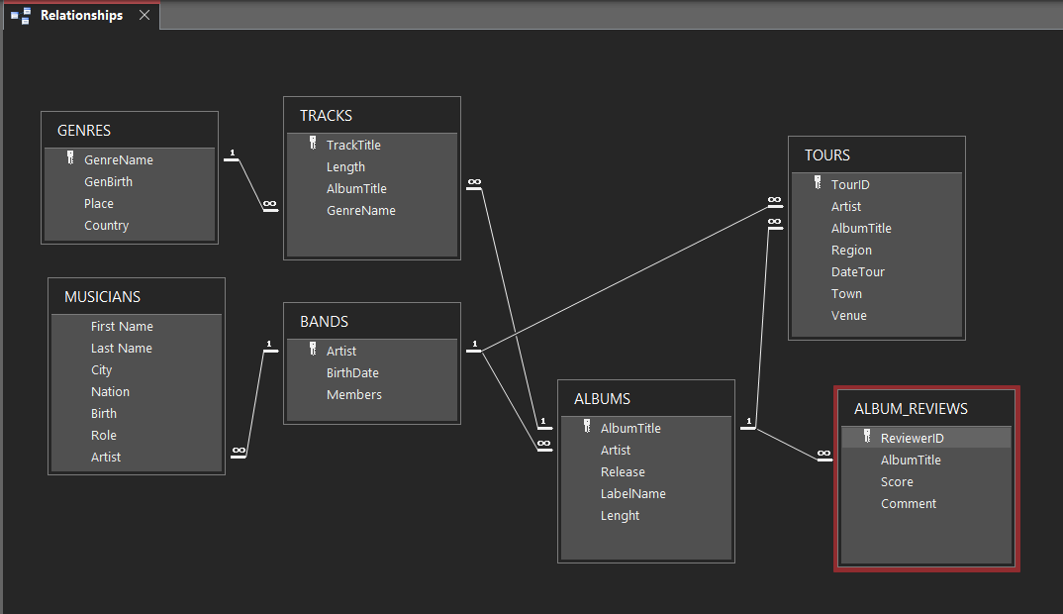
Clear idea

Slide 5
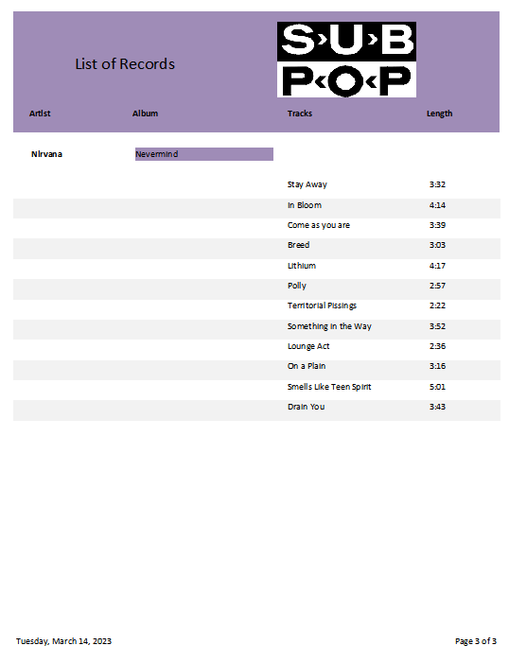

Slide 6
What DID GO Wrong?

Slide 7
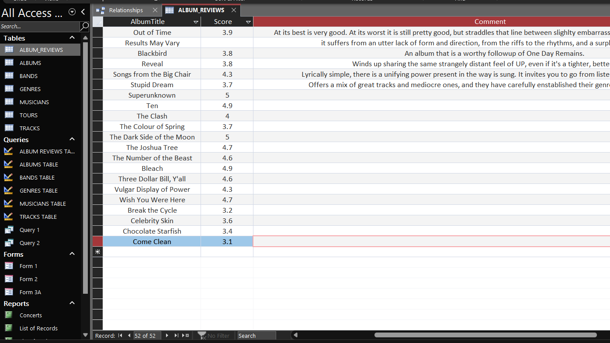
Missing data

Slide 8
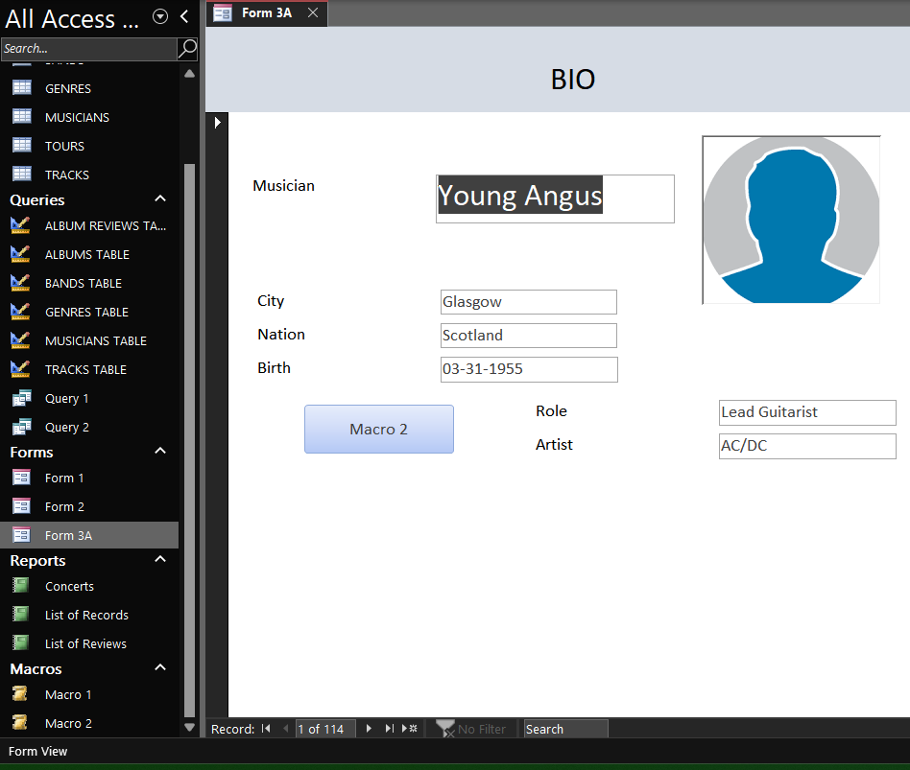
MACRO issues

Slide 9
What would you do differently?

Slide 10

Use a Different software

